Slide 1
Auto Focus Network

Slide 2
High Level Block Diagram
XY Coordinates
Obtain XY tile coordinates via micro magellan surface
Choose Tiles
Determine which tiles to focus on
Capture 3 plane images
At each determined tile, capture full frame images from 3 different z planes
Gaps between z planes is predetermined
Break Images into super pixels
Calculate reciprocal Brenner Score
Filter Brenner Score
Divide each image into an array of sub areas dubbed ‘super pixels’
Calculate brenner score for each super pixel and take reciprocal of it
Brenner score is pixel(col, row) – pixel(col + n, row).
Filter out background super pixels via ‘Well Depth’
Make Focus Prediction
Take 3 point reciprocal brenner score, solve quad equation and solve for derivative = 0 to find projected focus position. Use Gauss-Jordan reduction to solve
Fit Plane
Fit best plane to all points (X,Y, Predicted focus z position)
Use outlier dampening loss function to best fit with
Populate Focus Map
Use Plane(XY coordinates) to determine Z position for focus map
Pop FM array with depth of focus across 1 FOV
Z value in FM is top value. Work down when capturing more planes

Slide 3
Needed Methods
Generate FM array [x kinda]
Generate super pixel array(sp_y, sp_x, channel) [x]
Image subdivider [x]
Integrate image into super pixel array (image, channel) [x]
Tile chooser [x]
Auto Focus(channel)
Well Depth filter
Focus prediction populator
Plane fitter
Plane 2 FM map

Slide 4
FM Array Constructions
Contains all channel info
Numpy array with dimensions (10, y_tiles, x_tiles). X and Y tile count come from Micro Magellan array
Dtype = int16
9
Number Z slices A647 with depth of focus step sizes
8
Top Z position A647
7
Number Z slices A555 with depth of focus step sizes
6
5
4
3
2
1
0
X positions
Y positions
Top Z position DAPI
Number Z slices DAPI with depth of focus step sizes
Number Z slices A488 with depth of focus step sizes
Top Z position A555
Top Z position A488
10
If tissue is present = 1, if tissue is absent = 0

Slide 5
Super Pixel Array Array Constructions
1 Array per channel.
Numpy array with dimensions (5, y_super_pixel_count, x_super_pixel_count, 2).
y_super_pixel_count = int(super_pixels+per_image * y_tile_count *overlap_adjuster)
Dtype = float64
4
3
2
1
0
[Reciprocal Brenner Score plane 1, Z position]
[Reciprocal Brenner Score plane 2, Z position]
[Reciprocal Brenner Score plane 3, Z position]
[Predicted Focus Z position, Nothing]
Super Pixel Mask
[All pixels 0 or 1, Nothing]

Slide 6
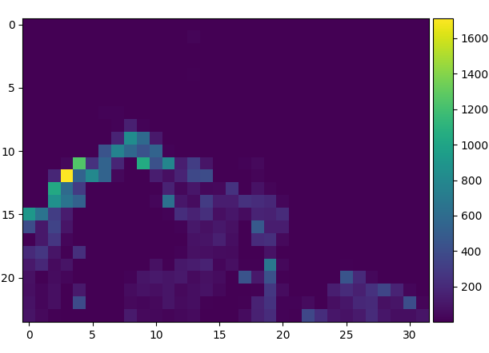
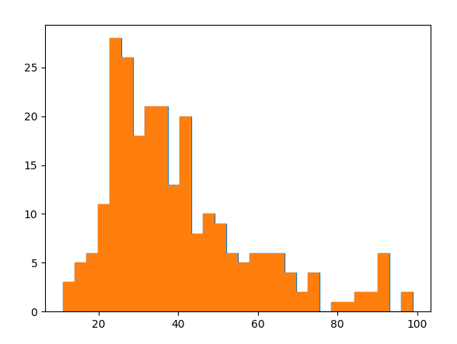
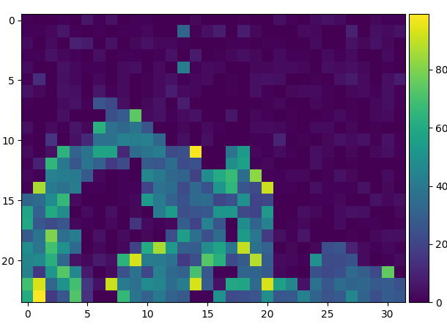
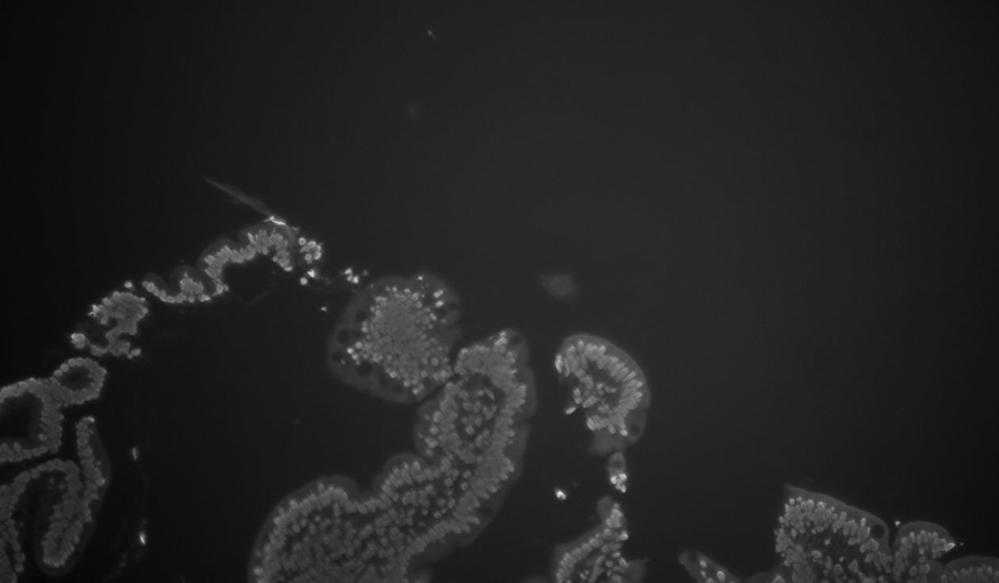
Setting Optimal Derivative Step Size (DAPI)
Super Pixel Image well depth
Max Derv Step Size Histogram
average 40
median: 35
std dev: 18
Super Pixel Image derv step size
Raw

Slide 7
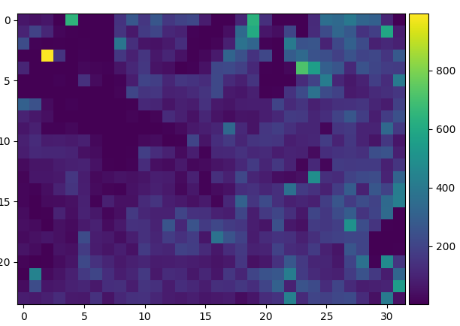
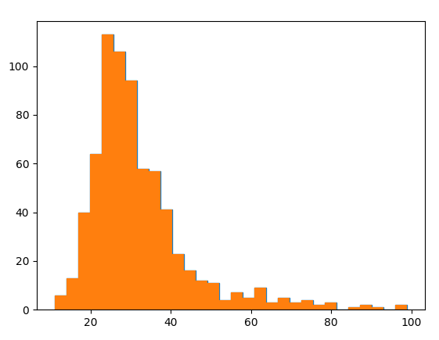
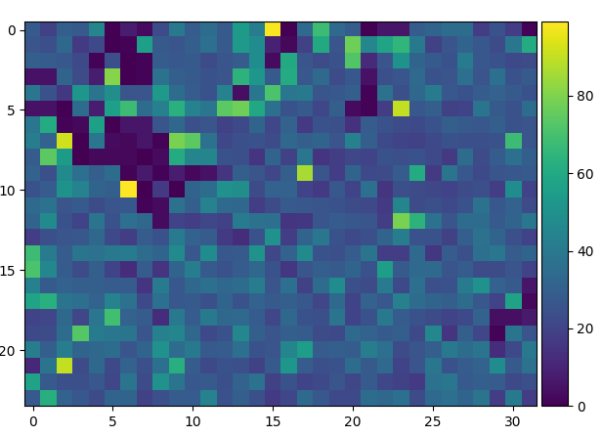
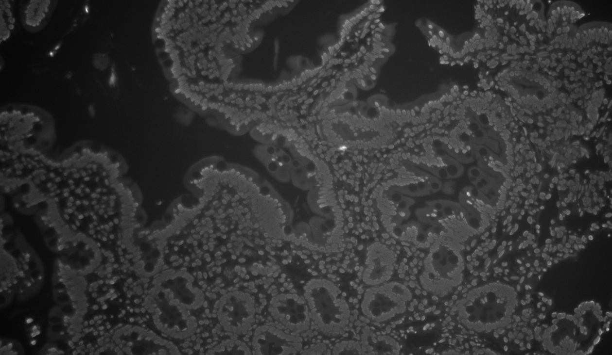
Setting Optimal Derivative Step Size (DAPI) 2nd image
Super Pixel Image well depth
Max Derv Step Size Histogram
average 32
median: 29
std dev: 13
Super Pixel Image derv step size
Raw

Slide 8
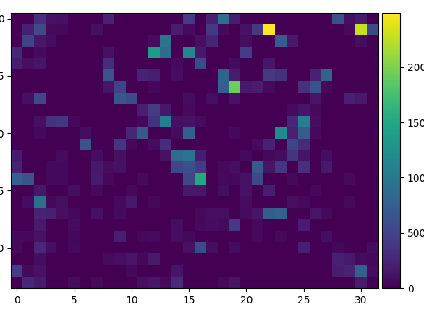
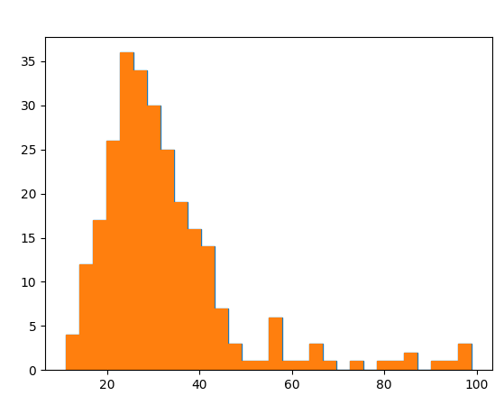
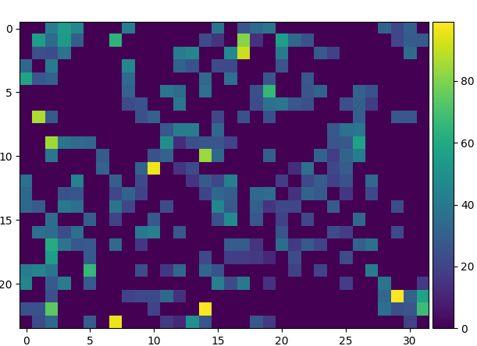
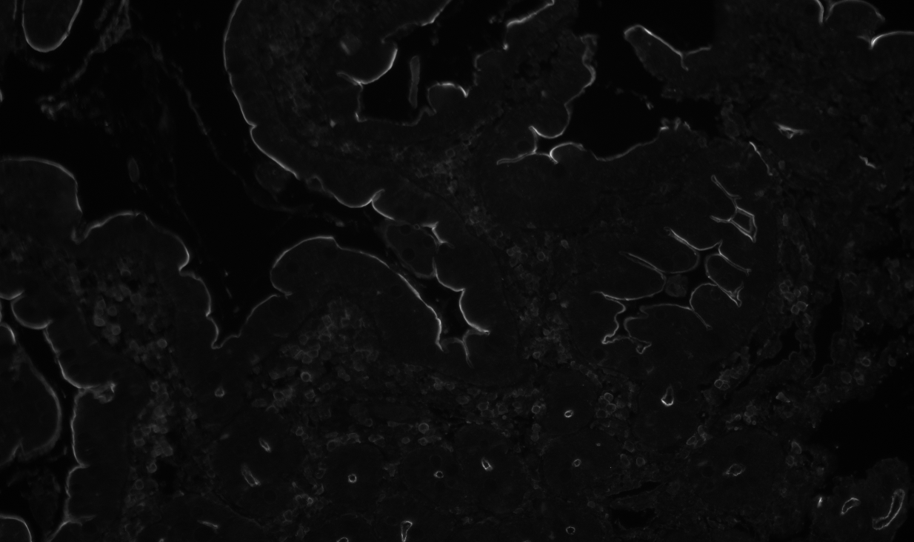
Setting Optimal Derivative Step Size (A488 Ezrin)
Super Pixel Image well depth
Max Derv Step Size Histogram
average 32
median: 29
std dev: 15
Super Pixel Image derv step size
Raw

Slide 9
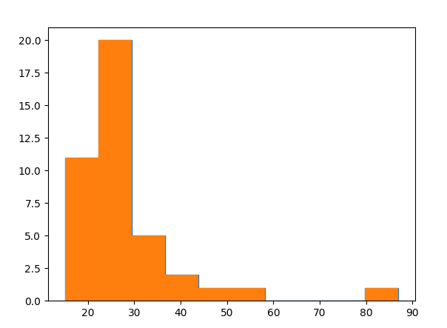
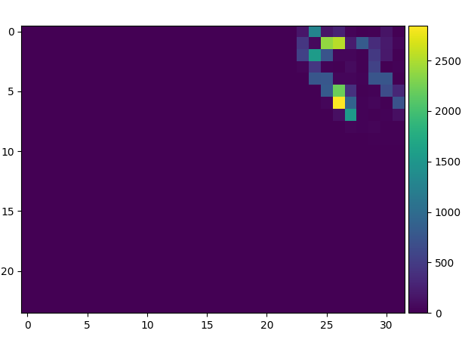
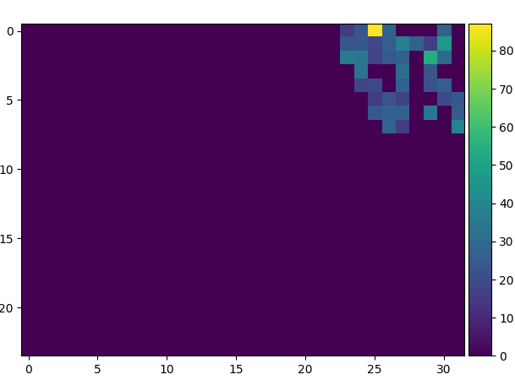
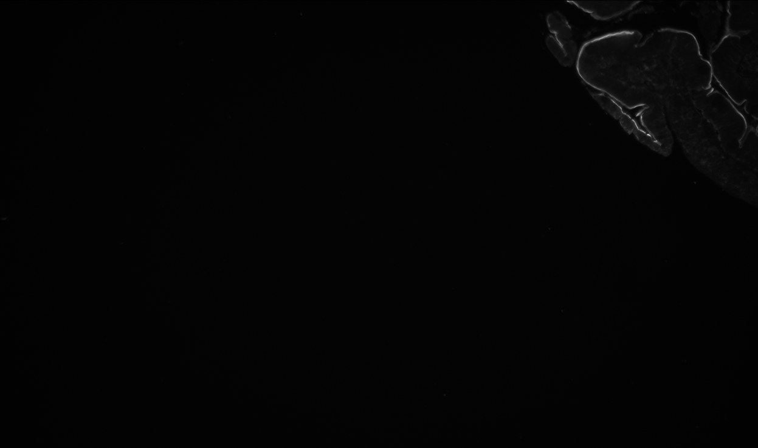
Setting Optimal Derivative Step Size (A488 Ezrin) 2nd image
Super Pixel Image well depth
Max Derv Step Size Histogram
average 28
median: 26
std dev: 12
Super Pixel Image derv step size
Raw

Slide 10
Auto Exposure Algorithm
Start from 100ms exp time
Go to XY tile position
Take image with given channel
Check if image is within bounds at the 99% percentile pixel
If saturated
reduce exp time by 10x
retake image and recheck if still saturated.
Repeat 1-2 until not saturated anymore
Scale exp to give 10% dynamic range intensity
If too low
Scale exp to give 10% dynamic range intensity or 1000ms, which ever one that is lower exposure time
If not saturated add to exp_calc_array and move to next z point
Repeat steps 1-4 until all 3 z points are acquired w/ same exp time. Must retake images if needed
Repeat steps 1-5 until all 4 channels are set
Repeat for all XY position with starting exp time being rolled over from previous XY position
Solve quadratic equation for all three intensity points via gauss Jordan reduction method to solve for all coefficients.
Find intensity that is predicted via derivative of quad equation set to zero and subbed back in.
Cycle through all results as a function of XY position to find the highest predicted intensity after being scaled by exp time.
Take desired intensity/highest intensity to make a scale factor
Take acquired exp time and multiply by new scale factor.
If new exp time > 2000ms, make = 2000
If less than 2000ms, don’t alter new exp time

Slide 11
Auto Expose Array Construction
1 Array per channel, delineated by index and not file name
Numpy array with dimensions (4 (channels), y_tiles, x_tiles, 4, 3).
Dtype = Int16
3
2
1
0
[X percentile intensity in image 1, Z position, exp_time ]
[X percentile intensity in image 2, Z position, exp_time ]
[X percentile intensity in image 3, Z position, exp_time ]
[Predicted in focus intensity, predicted focus]
3
2
1
0
[X percentile intensity in image 1, Z position, exp_time ]
[X percentile intensity in image 2, Z position, exp_time ]
[X percentile intensity in image 3, Z position, exp_time ]
[Predicted in focus intensity, predicted focus]
3
2
1
0
[X percentile intensity in image 1, Z position, exp_time ]
[X percentile intensity in image 2, Z position, exp_time ]
[X percentile intensity in image 3, Z position, exp_time ]
[Predicted in focus intensity, predicted focus]
3
2
1
0
[X percentile intensity in image 1, Z position, exp_time ]
[X percentile intensity in image 2, Z position, exp_time ]
[X percentile intensity in image 3, Z position, exp_time ]
[Predicted in focus intensity, predicted focus]
DAPI = index 0
A488 = index 1
A555 = index 2
A647 = index 3

Slide 12
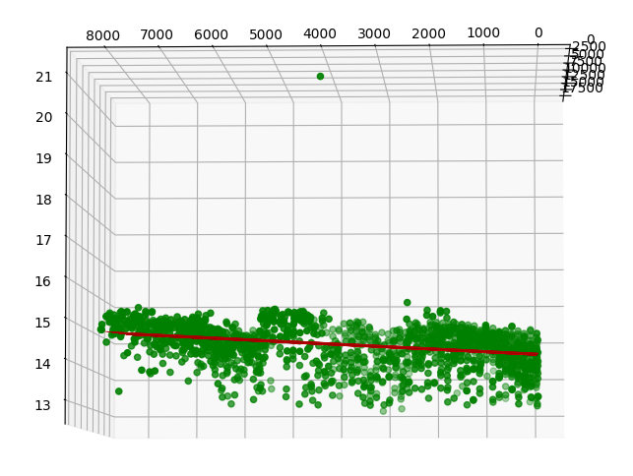
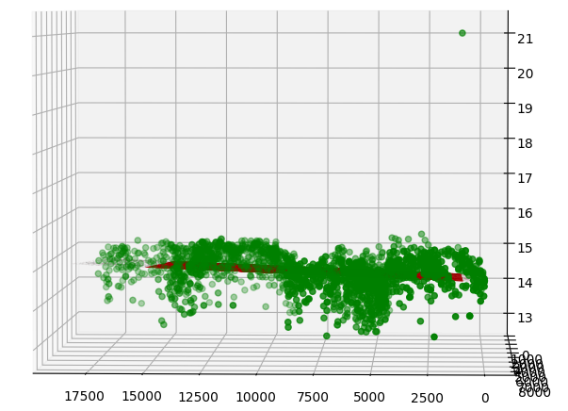
5.6 seconds for all processing with 12 tiles

Slide 13
Autofocus
New auto focus will utilize the 3 images from autofocus and project out what the approximate ideal exposure would be.

Slide 14
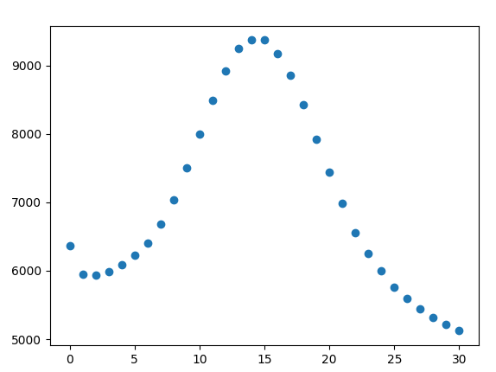
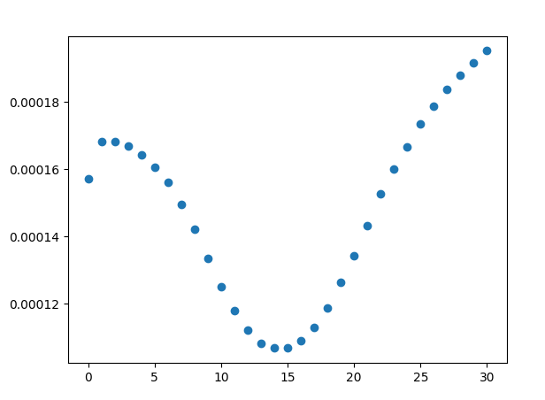
Plot highest int value of the bottom 99% pixels vs slice in image array
Also plot 1/highest pixel
Plot z slices 7-22 and fit reciprocal to quadratic equation
Fits very well!

Slide 15
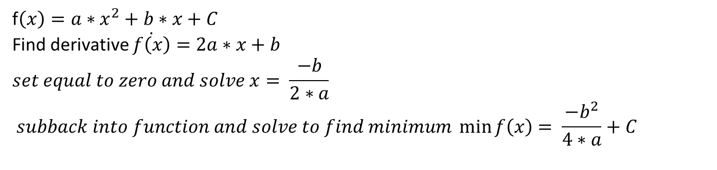
Intertwining Auto Focus and Auto exposure
f$\left(x\right)=a∗x^{2}+b∗x+C$
Find derivative $\dot{f\left(x\right)}=2a∗x+b$
$$set equal to zero and solve x= \frac{−b}{2∗a}$$
$$subback into function and solve to find minimum \min_{}{f\left(x\right)= \frac{−b^{2}}{4∗a}+C}$$

